Slide 1
Turbomachinery CAD Francis Turbine
Course Work Module - Trinity Term ‘24
Kam Chana and Ben Fudge
Notes:
Welcome
Any probs in completing this course – please tell us!

Slide 2
Demonstrators week 7…
Monday Kam, Ben, Joe
Tuesday Ben, Kam, Joe
Wednesday Ben, Joe
Thursday Ben, Kam, Joe
Friday – Kam, Ben
Tuesday Lecture by Prof Kam Chana

Slide 3
Demonstrators week 8…
Monday Kam, Ben, Joe
Tuesday Ben, Kam, Joe
Wednesday Ben, Joe
Thursday Ben, Kam, Joe
Friday – Kam, Ben
Tuesday Lecture by Prof Kam Chana

Slide 4
Mechanical / Civil CAD
Objectives
Gain insight into the use of CAD
Further experience of SolidWorks
Solid & surface modelling of turbine components
Motion analysis and redesign of mechanism
Drawings and animation
Design runner to target performance
Process runner test results to give turbine efficiency
Write report
Notes:
SW learning – useful in yr 3 & 4
Is a versatile tool for engineers
Broad applications - Solids, drafting, Assemblies, kinematics, FEA, Modal, etc
CAD for industry
Reinforce Fluid Mechanics theory and design runner inlet and outlet angles for target op conditions.
4 types of runner
CAM benefits in manufacturing - later
Our component “2½D”

Slide 5
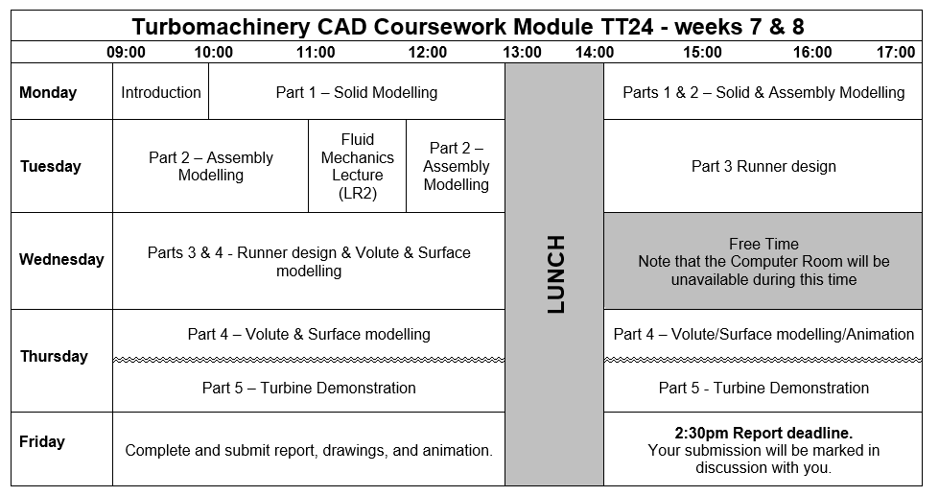
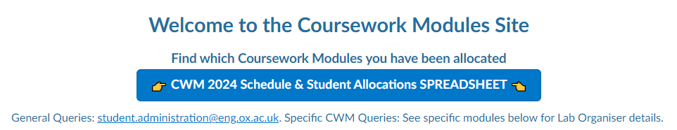
(see Canvas - student allocation)
Notes:
Explain practicalities
Schedule is in intro handout (we won’t stick to it rigidly)
Fluid Mechanics Lecture

Slide 6
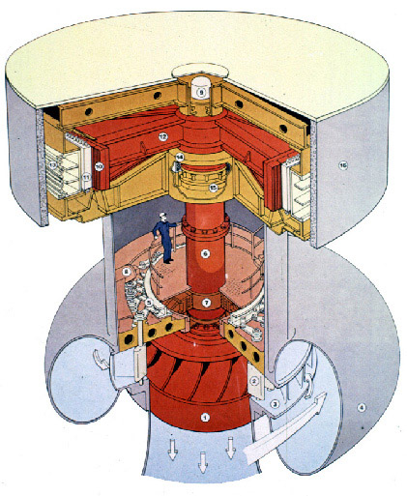
Francis Turbine
Notes:
Cross section of francis turbine.
Point out:-
Scroll involute, guide vanes and control mechanism, runner, driveshaft, bearings, draft tube, generator
3D profile of runner – seen better in next slides.

Slide 7
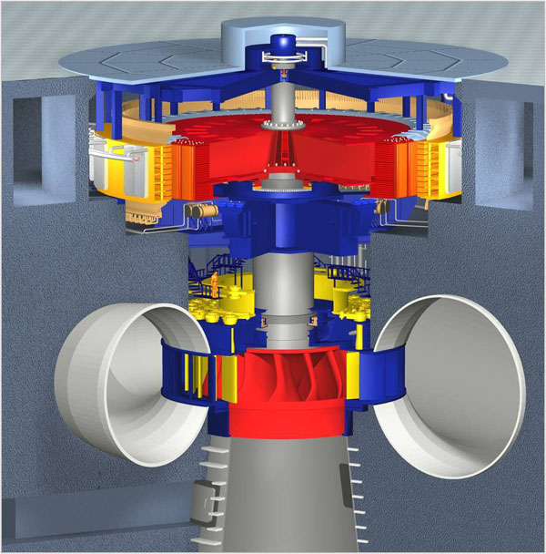
Francis Turbine
Generator Rotor
Driveshaft
Generator Stator
Bearings & Seals
Runner
Guide Vanes
Involute Scroll
(Inlet)
Draft Tube
(Outlet)
https://www.micro-hydro-power.com/Engineering.htm
Notes:
Scale – point out operator!

Slide 8
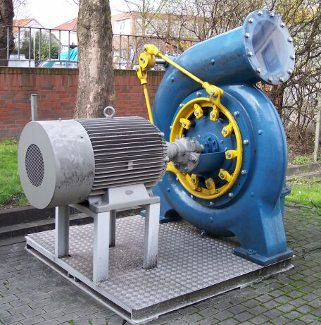
Francis Turbine
https://commons.wikimedia.org/wiki/Francis-Turbine#/media/File:Francis_Turbine_complete.jpg
Notes:
Small turbine :-
Scroll tube
Guide vane control mechanism
generator

Slide 9
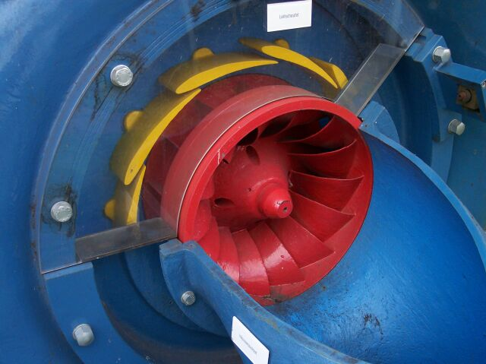
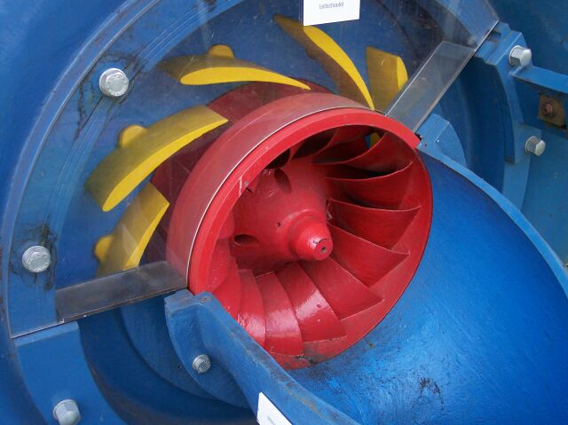
Francis Turbine
https://commons.wikimedia.org/wiki/Francis-Turbine#/media/File:Francis_Turbine_High_flow.jpg
File:Francis_Turbine_Low_flow.jpg
Notes:
Small turbine :-
Runner
Guide vanes low and high flow.
Why control speed?
Need a constant speed to generate at specific AC frequency, vanes (and diversions used to control this with varying demand)
Input power is proportional to Flow x Head

Slide 10
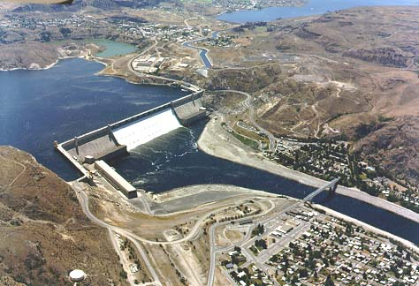
Grand Coulee Dam
http://www.ifiberone.com/news/grantcounty/couleecity/grand-coulee-dam-american-legion-post-honored/article_ada097ca-197f-11e2-8bfa-001a4bcf6878.html
Notes:
Columbia Basin, Washington State, USA. The largest power production facility in the USA
(Three gorges dam in China – 3 x bigger power production + 3 x as much concrete)
Dam is largest concrete structure ever built. (9.2million m^3 concrete)
Left Powerhouse = 3 x 10MW + 9 x 125MW = 1155MW
Right Powerhouse = 9 x 125MW = 1125MW
Construction between 1933 and 1942. Turbines commissioned between 1941 and 1950
The turbine runners are currently being replaced – 1st in 2001 - efficiency measured at 95.6% (was 92)
2 others by end 2003. Work ongoing.
The scheme provides flood control, irrigation, hydropower production, recreation, and wildlife benefits.
Franklin . D Roosevelt lake is 151 miles long

Slide 11
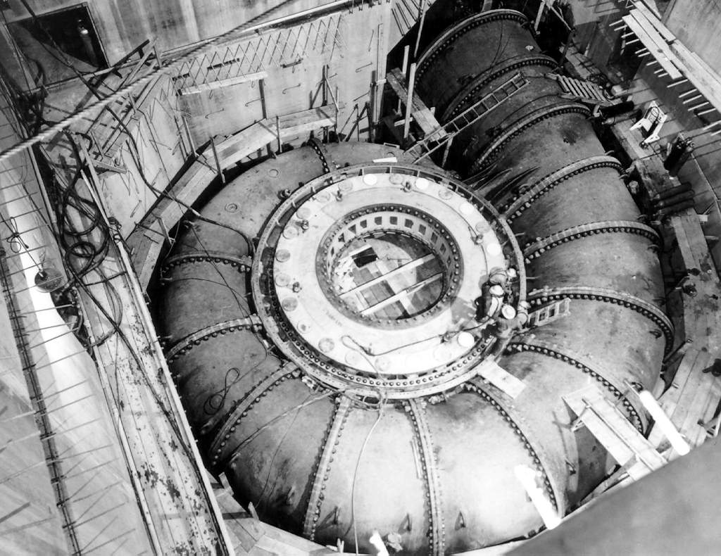
Francis Turbine – scroll casing
http://users.owt.com/chubbard/gcdam/html/photos/construction.html
Notes:
Scroll casing for turbine in the Grand Coulee dam (3rd powerplant).
3rd Powerhouse = 3 x 600MW + 3 x 800MW = 4200MW Building started in 1967, and turbines commissioned between 1975 and 1980
Total 6480MW, but runs at an average 1/3 capacity over year - (2400MW)
Each generator fed by individual Penstock – largest is 12.2 m diameter carrying up to 1000 m^3/sec Water Head 100m
Average water release over 1 year is 3200m^3/sec

Slide 12
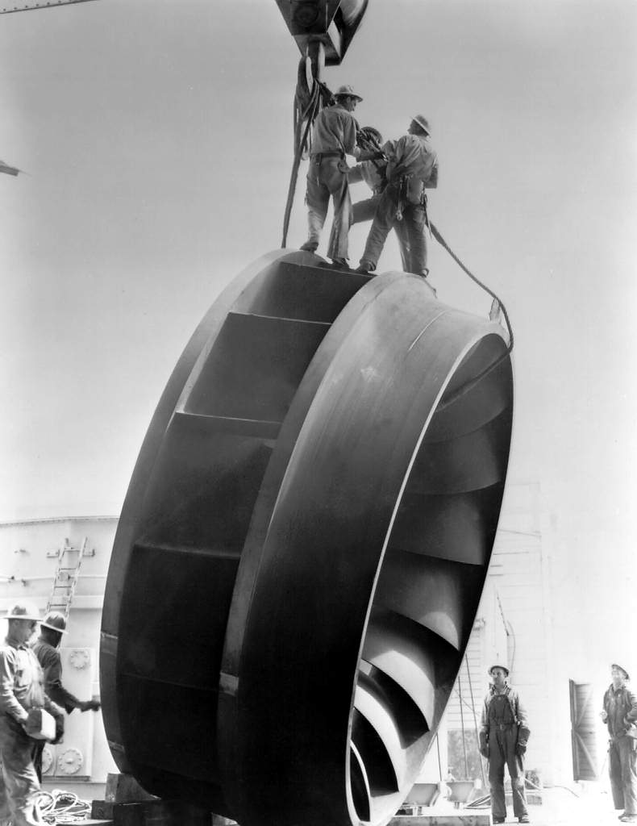
Francis Turbine - Runner
http://users.owt.com/chubbard/gcdam/html/photos/construction.html
Notes:
Runner for original Plant? – 1940’s

Slide 13
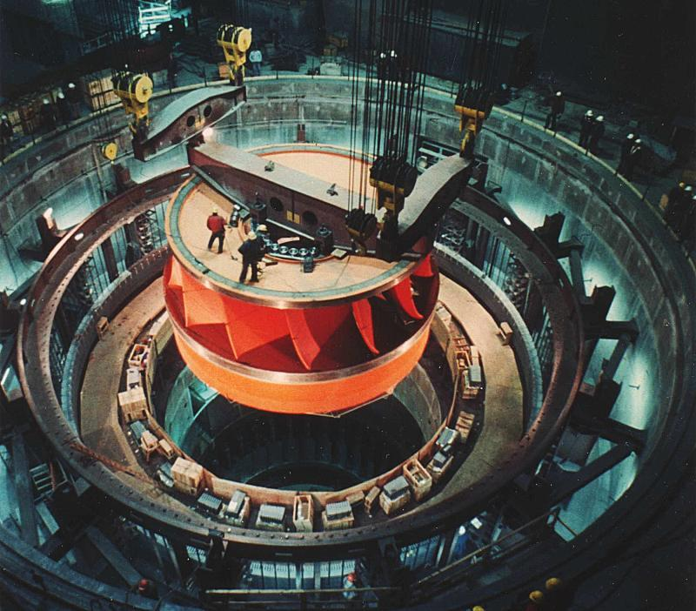
Francis Turbine
https://en.wikipedia.org/wiki/Grand_Coulee_Dam#/media/File:Water_turbine_grandcoulee.jpg
Notes:
Installation of Runner in 3rd Plant – early 1970’s

Slide 14
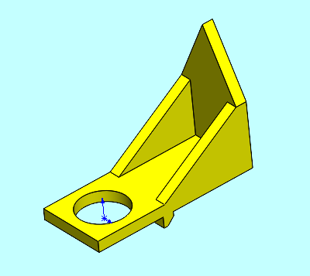
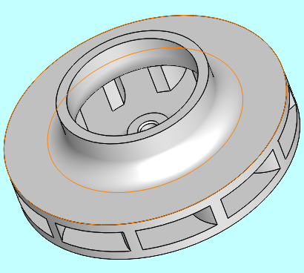
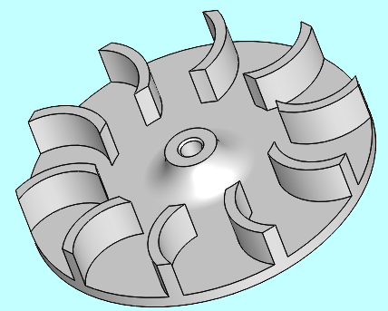
Component Modelling
Notes:
Solid modelling
Indicator & runner shown
Instructions given for first parts
Runner is shown this part spins at 1300rpm
Fed by adjustable guide vanes (in next slide)
Design angles - Flow is radially inwards

Slide 15
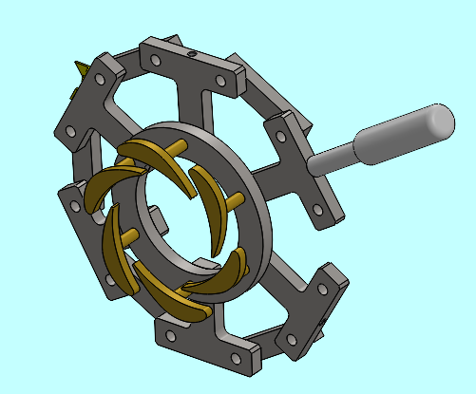
Motion Analysis
Notes:
Linkage to control flow
Explain how it works
Assembly of components
Use the drawings provided to aid construction.
Analyze mechanism kinematics
Care required when creating joints

Slide 16
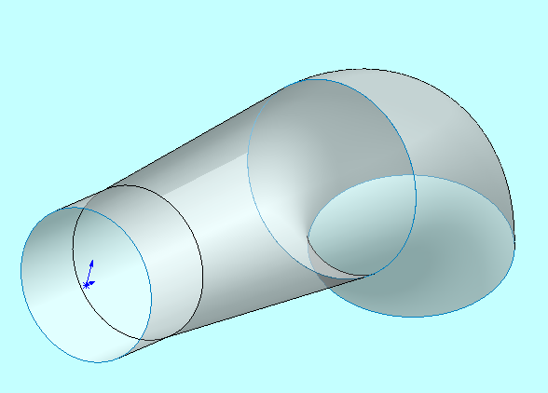
Surface Modelling
Notes:
Surface modelling – appropriate for certain types of geometry (compound curves).
Not the only way
Shell to create solid
Describe volute, and draft tube.

Slide 17
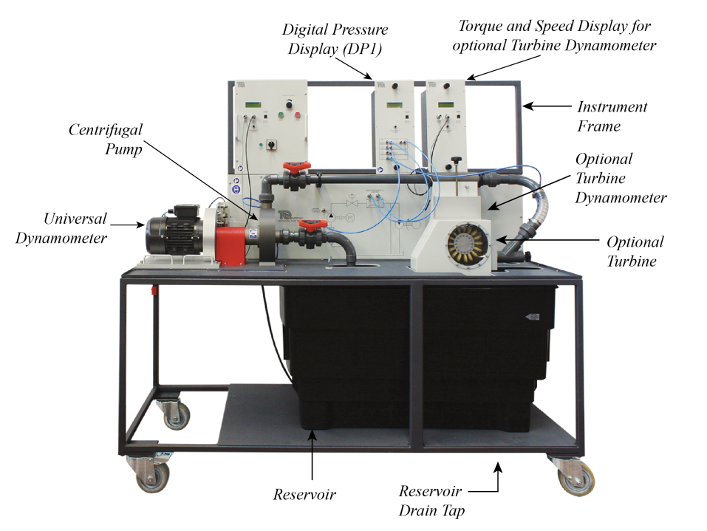
Turbine Test Bench
Notes:
Explain annotations

Slide 18
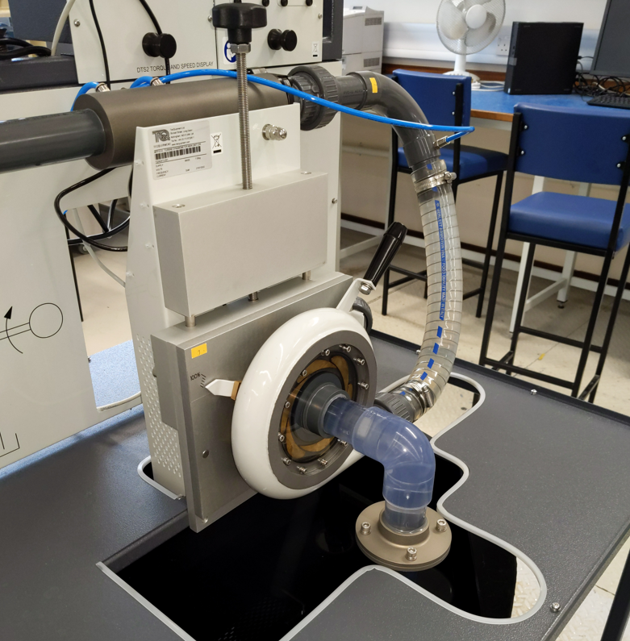
Francis Turbine
Notes:
Dynamometer
Volute
Inlet
Guide vanes
Explain flow

Slide 19
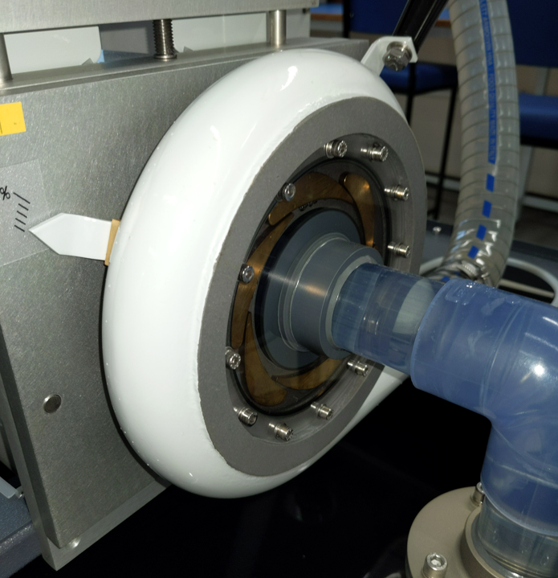
Francis Turbine
Notes:
GV’s a little clearer.
Runner in centre
Indicator on left.

Slide 20
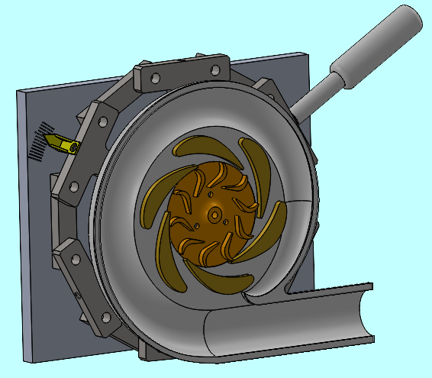
Turbine Runner
Notes:
Explain rotation – clockwise in picture.
Ideally vane would be 3D curve, but very hard to make!

Slide 21
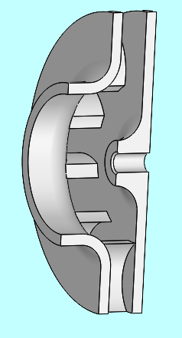
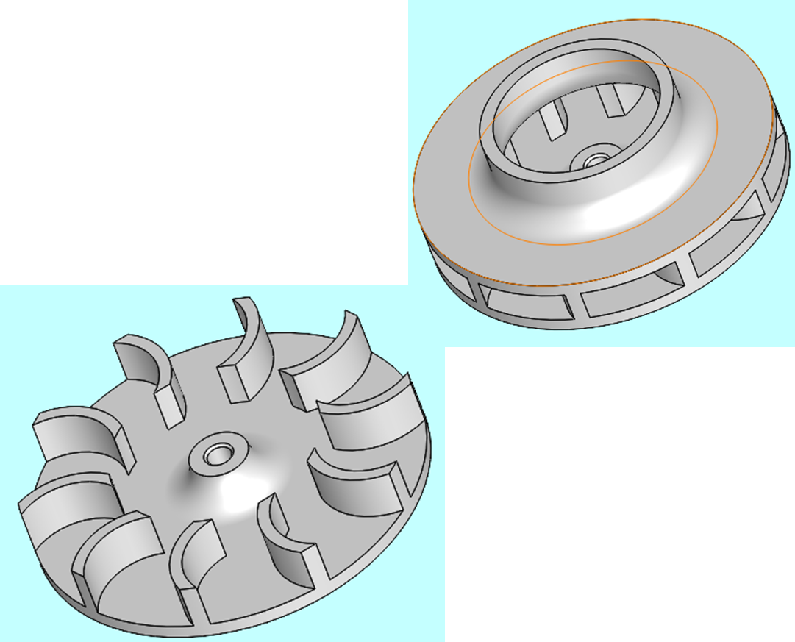
Turbine Runner
Notes:
Explain rotation – clockwise in picture.
Ideally vane would be 3D curve, but very hard to make!

Slide 22
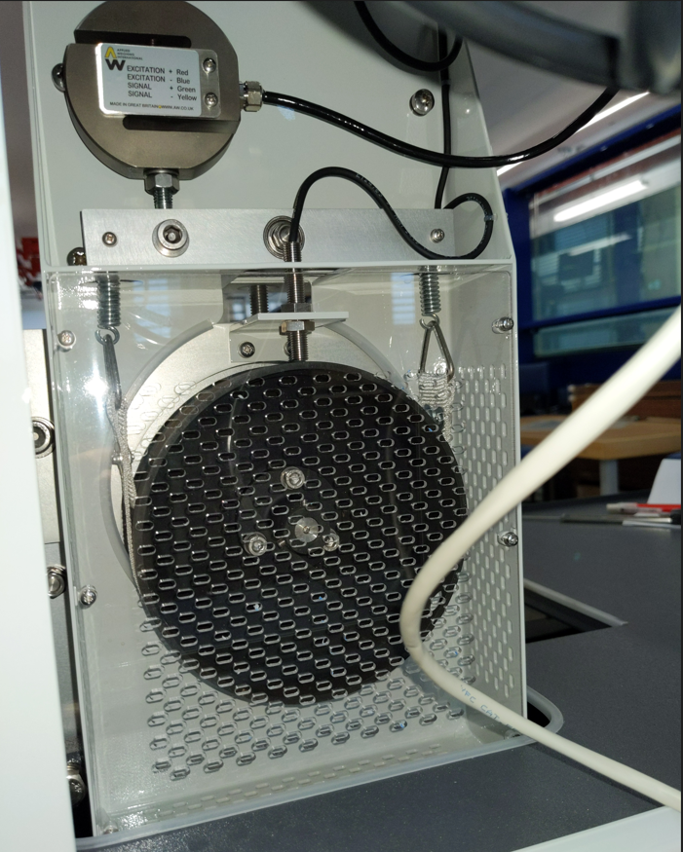
Dynamometer
Notes:
Explain
Belt brake
Load sensor
Speed sensor

Slide 23
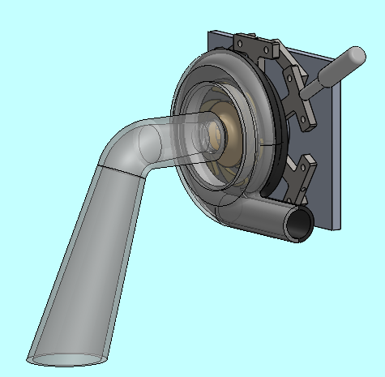
Draft Tube
Notes:
Draft Tube expands in an attempt to recover some energy.
Not how the experimental Turbine is set up (yet).

Slide 24

Turbomachinery CAD
How to use SolidWorks
Always use Smart Dimension
Use Edit Sketch or Edit Feature to modify parts
Refer to 1st year notes on Canvas
Instruction given for first part
Save regularly !!
Notes:
Show basics.
Simple part creation using Smart Dimension.
Editing of features & sketch.
View manipulation – with mouse and spacebar + create new view (beneficial for drawings).
Demo SolidWorks -Show ‘Intro’ presentation.
Extrude, cut, normal to icon, create assembly (simple pin in cube), mates, window, use the mouse to zoom, rotate. Resize icon. Wireframe icon.

